Slide 1


Getting Started with Web Development and the ArcGIS API for JavaScript
Heather Gonzago and Jose Banuelos
2022 ESRI DEVELOPER SUMMIT
Notes:
2022 Esri Developer Summit

Slide 2

Demos and slides available at https://bit.ly/3vYoMHg

Slide 3

Agenda
Where to start (doc)
Accessing the API
Introduce the Map, WebMap, WebScene
Introduce the MapView and SceneView
Demo
Add a layer
Add a renderer
Add a popup
Work with widgets

Slide 4

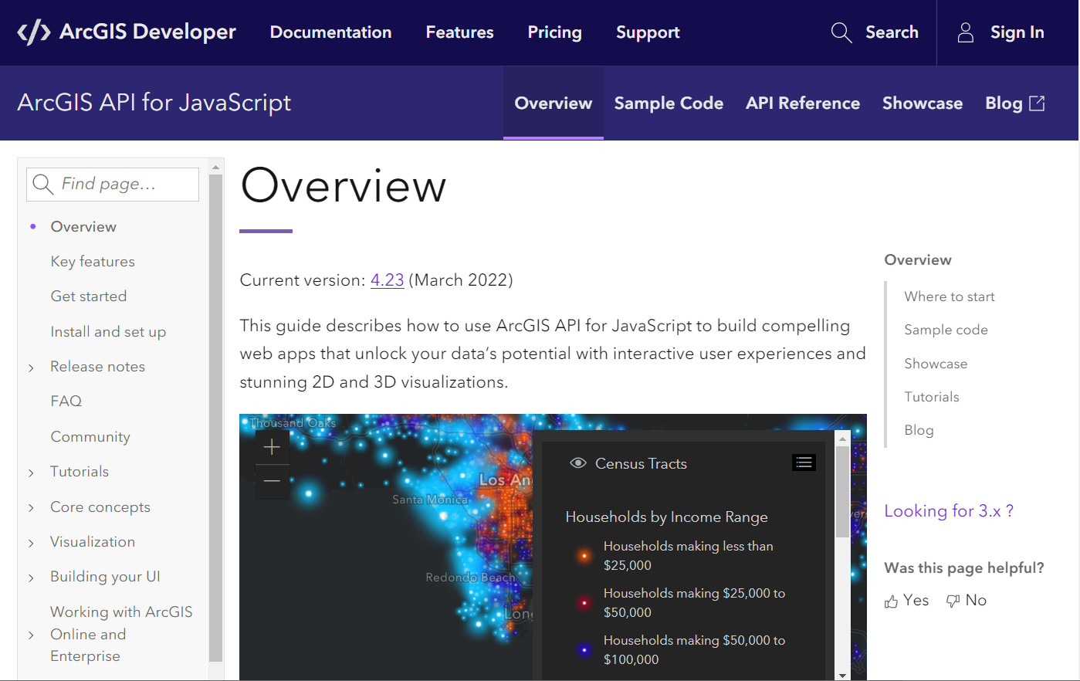
Where to start?
ArcGIS for Developers
Install and set up
Tutorials
Over 200 samples

Slide 5
Accessing the API (CDN)
AMD modules via ArcGIS CDN
Most common approach

Slide 6
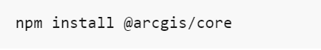
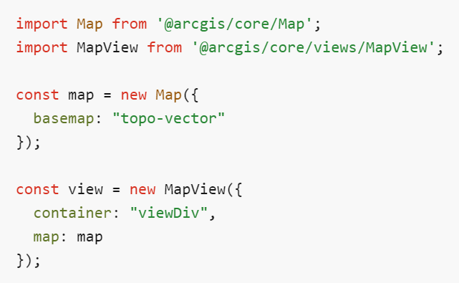
Accessing the API (ESM)
ES modules via NPM
Available via npm
Install the API locally for use with JavaScript frameworks and module bundlers

Slide 7
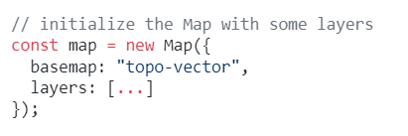
Map, WebMap, WebScene
Map
Container that stores, manages, and overlays layers
Can add/remove layers for 2D and 3D

Slide 8
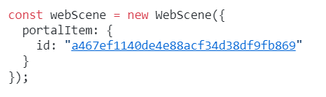
Map, WebMap, WebScene
WebMap / WebScene
Can load a WebMap or WebScene from ArcGIS Online or ArcGIS Enterprise portal
Data can contain pre-configured renderers, popups and bookmarks
Easy to use and reduces lines of code

Slide 9
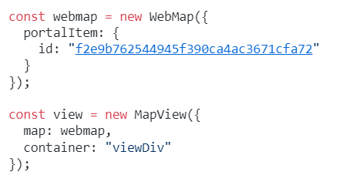
MapView and SceneView
The view renderers a Map and its layers
The view provides the means of viewing and interacting with the components of a Map
MapView – 2D | SceneView – 3D

Slide 10

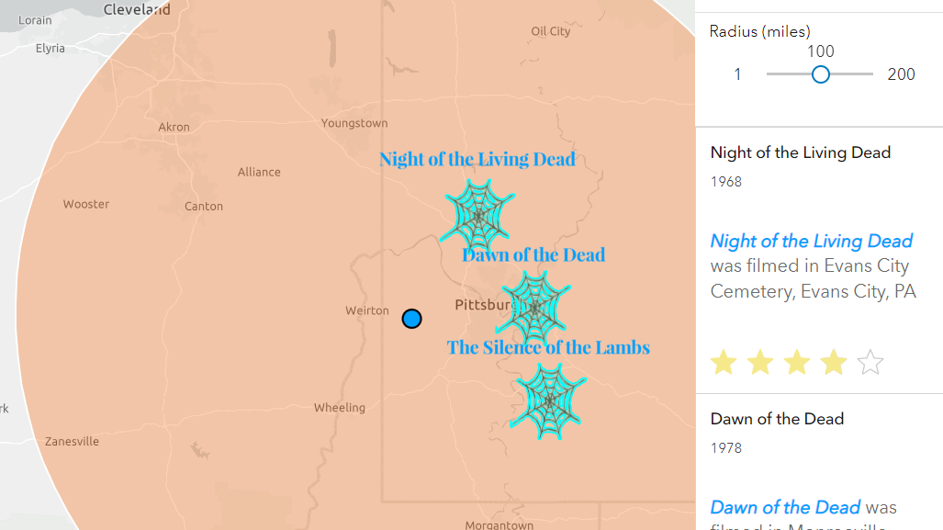
Create our first app
Jose Banuelos

Slide 11
Demos and slides available at https://bit.ly/3vYoMHg

Slide 12




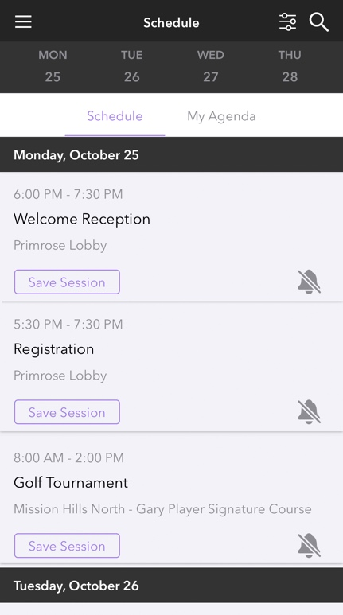

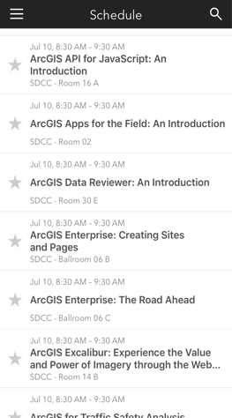
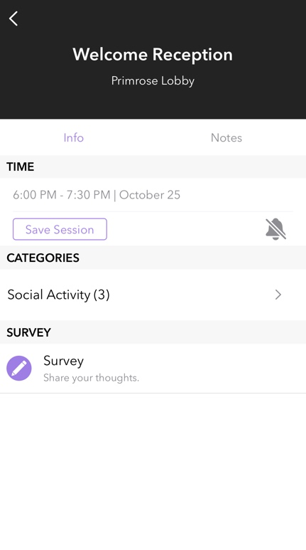

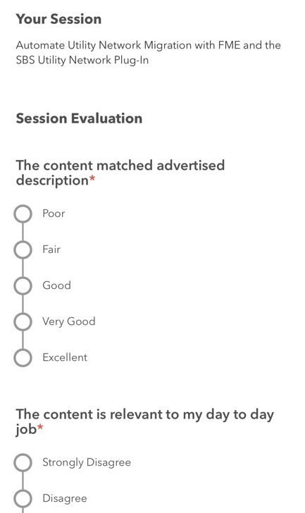
Please Share Your Feedback in the App
Download the Esri Events app and find your event
Select the session you attended
Scroll down to “Survey”
Log in to access the survey

Slide 13
Questions?

Slide 14



Copyright © 2022 Esri. All rights reserved.

